Slide 1

Austin Peay State University
Accounts Payable
PO Box 4635
Clarksville, TN 37044
Browning Building, Room 146
(931) 221-1037

Slide 2
Accounts Payable Staff
Name | Position/Vendor | Contact Information
Kristi Moore | Accounts Payable Supervisor A-F/Fed Ex/Stipends | (931) 221-7692 moorekl@apsu.edu
Geraldine Garner | Travel | (931) 221-7373 garnerg@apsu.edu
Anita McKnight | G-N/Capital Projects and Contracts/All Athletics Medical Billing/Records Custodian | (931) 221-7694 mcknighta@apsu.edu
Lisa Parker | O-Z/Bookstore/Library/ Enterprise/all Utilities/ back up Records Custodian | (931) 221-7251 parkerl@apsu.edu
JaimeTe Joshua | Data Entry/back up Records Custodian | (931) 221-1037 joshuaj@apsu.edu

Slide 3
What does Accounts Payable process?
Business Meal Reimbursements
Payment Authorizations
  Personal Reimbursements
Purchase Orders
Travel Claims & Advances
Contract Payments
  Personal Service Agreements
Awards & Stipends
Journals, Fuploads & Expenditure Transfers

Slide 4
When can payment be expected?
A payment authorization can take as long as thirty days to be processed. We receive multiple requests each day and work them in the order received. The more detailed your request, the less likely chance that it will be delayed. Please attach all required documentation so we don’t have to ask for it.
For example: itemized and credit card receipts, invoices, any other supporting documentation
Do not make promises to anyone regarding a time frame of payment. The only people authorized to do this are the Accounts Payable staff. Only we know what we have waiting to be processed for reimbursement.
If you submit a request that needs special attention, please call or email us so that we are aware. Otherwise it falls in line with all other requests.
When you submit a payment authorization or receive on a purchase order, you are only alerting us that something needs to be paid. You have not made a payment. Accounts Payable staff are the only ones that can make a payment on a payment authorization or purchase order.
We process both paper checks and ACH payments. A direct deposit is usually in the vendors account no more than three days after we process the payment.

Slide 5
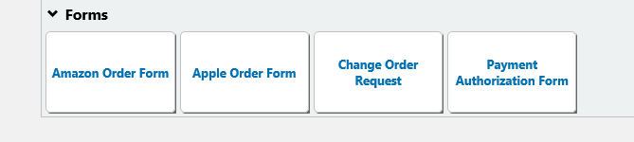
What is the difference between a Payment Authorization or Purchase Order?
A payment authorization is for purchases made “after the fact” in other words, you have already purchased the item. Your order is not sent directly to the vendor, but we receive an invoice instead. All invoices should come directly to Accounts Payable. A payment authorization should be used for a purchase under $10,000 ONLY. You will use the Payment Authorization Form in Govs eShop. The Payment Authorization tab can be found on the bottom row of the home screen in Govs eShop.
You cannot ask for separate invoices to stay under the payment authorization amount.

Slide 6

What is the difference between a Payment Authorization or Purchase Order continued…
A purchase order is used for purchases “before the fact” in other words, you need to make a purchase. A purchase order should be used for all single or combined purchase totals of $10,000 and above. You should click on the non-catalog item tab or contract routing form if applicable in Govs eShop to initiate your order. This will send a written order to the vendor once all approvals have been granted.
ALL software requests (regardless of the amount) should be submitted on a Purchase Order using account code 74430 which will route through IT for appropriate approvals.

Slide 7
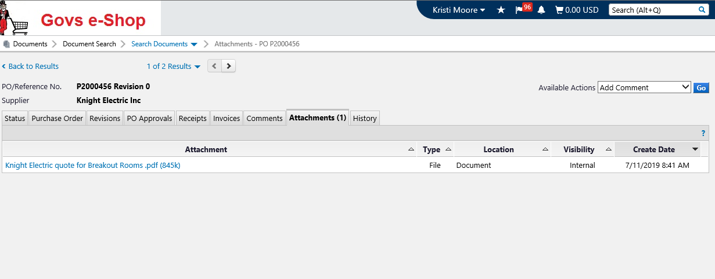
Purchase Orders
If you have a purchase order, please remember to add invoices under the attachments tab. Under available actions click Add Comment then Go…

Slide 8
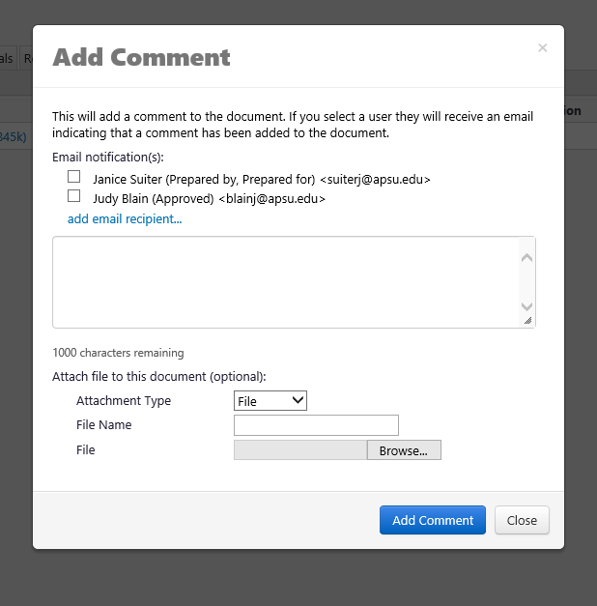
Attaching Invoices and Adding Comments continued…
Add one of us as the email recipient
Add a comment
Add a file name
Attach your file
Click on Add Comment
If we comment to you in Govs eShop, please don’t email us your response. Please comment back in Govs eShop so everything is in one place.
When you add something in the file name, keep it short and sweet. It is only about 20 characters.
Think about what is identifiable and what will make searching easier for your department, accounts payable or the auditors later on.

Slide 9
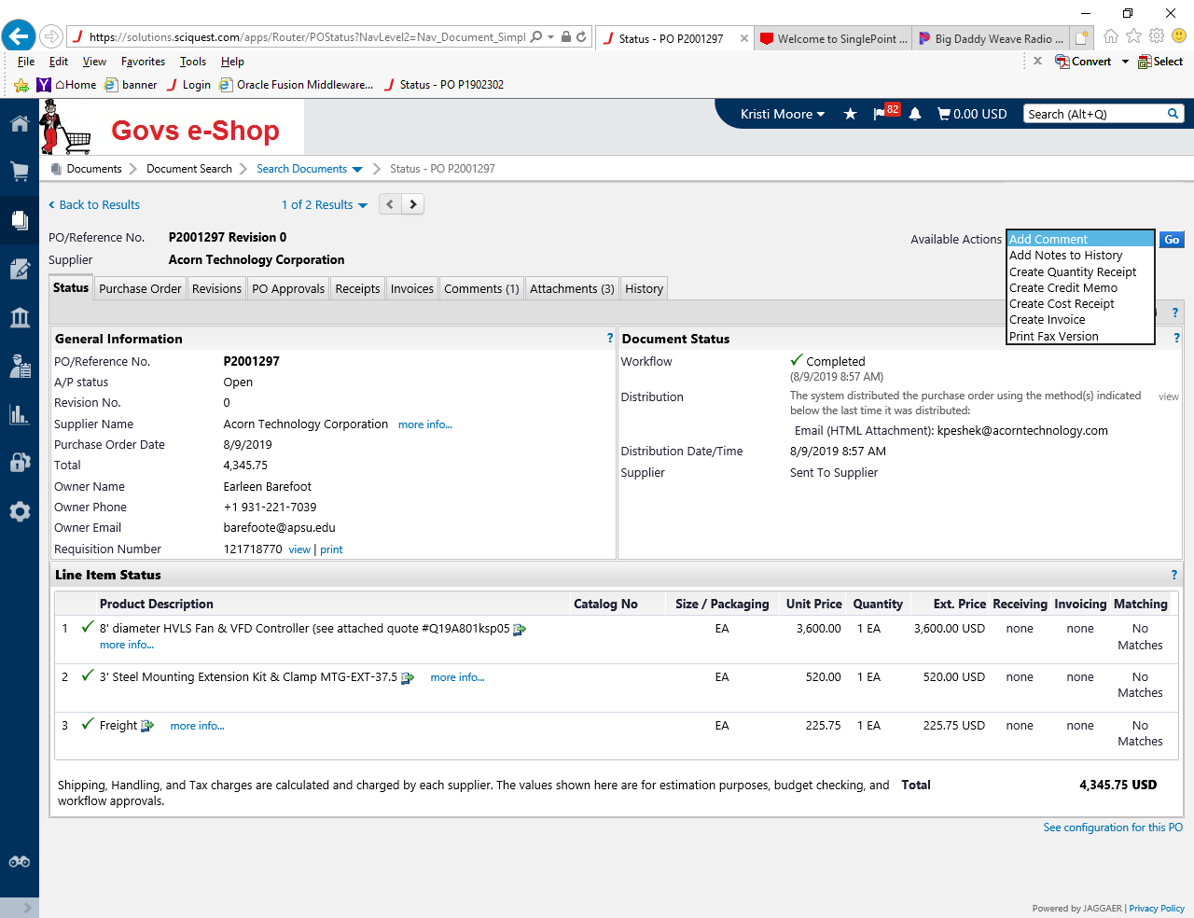
Receiving Reports
Receiving should be done on a Purchase Order to authorize payment

Slide 10
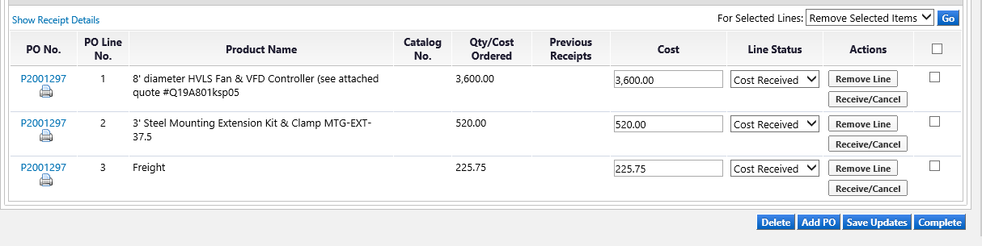
Receiving Reports continued…
If you have already received an item, click Remove Line so you don’t over receive it
Choose the line(s) you would like to receive
Check the box to the right of your item
When finished, click Complete

Slide 11
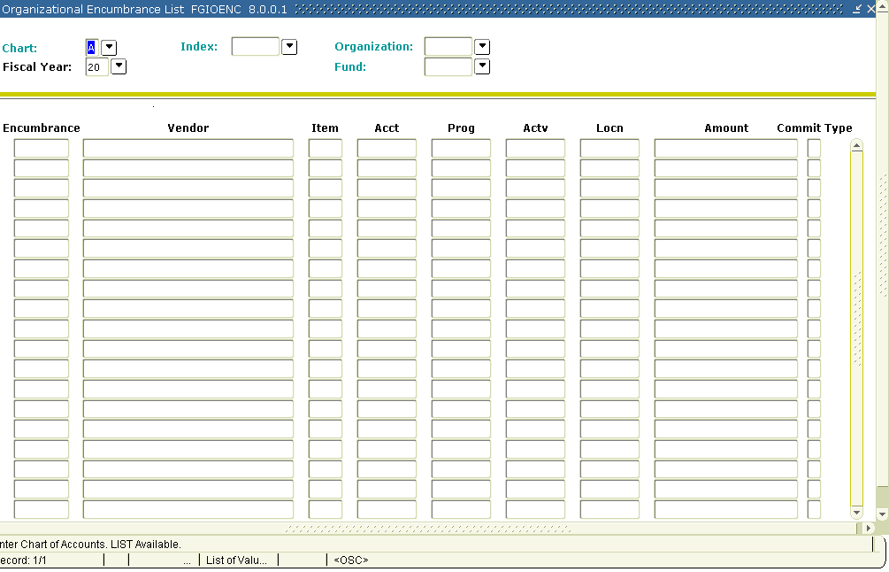
Open Encumbrances
You should have query access to FGIOENC in Banner. This screen will allow you to search by your Fund and Org for a list of encumbrances. You will have to remember to change the chart to F for a Foundation FOAP.

Slide 12
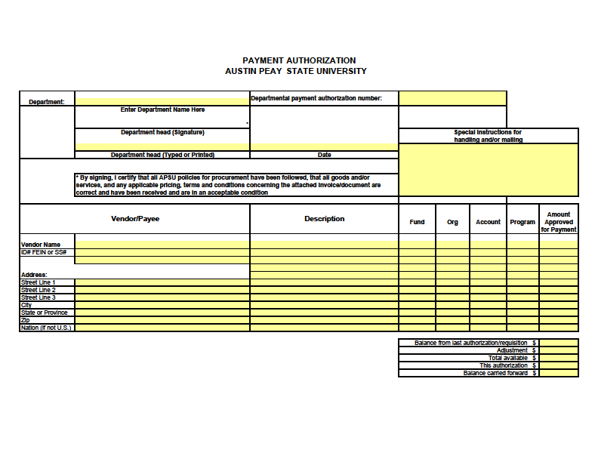
Payment Authorization
Notes:
An 8 account does not have an org or program code. A paper payment authorization is used primarily for agency accounts or accounts not in Govs eShop. Occasionally, we will allow these on one time reimbursements.

Slide 13
Automated and Paper Payment Authorization
Payment authorizations are required for payment of items totaling less than $9,999.99
PLACING SEPARATE ORDERS TO GET BELOW THE $9,999.99 LIMIT IS A VIOLATION OF STATE POLICY!
If you have multiple invoices, please enter them separately.
Business Meals – please provide sufficient details. We need to know the date of your meal or event, reason for your meal or event, name of all guests in attendance as well as names of university personnel in attendance.
If you use a personal MasterCard, please leave a comment that a personal card was used and that it was not the university purchasing or travel card.
Reimbursements – please be detailed. The more information you provide, the less likely your request will be delayed. Provide the date and reason for your purchase as well as proof of purchase.
You cannot submit a request in Govs eShop using both an A and F chart FOAP. You must use one or the other.

Slide 14
Automated and Paper Payment Authorization
Retirement Events – Departmental funds may be used for food and refreshments up to $200.00 per office or departmental recognition/retirement event. You are required to use Chartwells for these events.
Subscriptions/Renewals are for one year only
Accounts Payable does NOT place orders nor do we contact vendors when you have issues with your order. This is the responsibility of the department placing the order.
  Do not send a payment authorization to us or enter a requisition in Govs eShop until the items are ready to be paid for, i.e. have been received in a satisfactory manner
We do not control your budgets, nor do we keep track of how much you spend
Do not wait on an invoice to submit a payment authorization
  All invoices should be sent to Accounts Payable
  If you receive the invoice, then please attach it in Govs eShop when submitting your requisition. Make sure to use the attachments tab and choose one of us as the email recipient. This lets us know there is something that requires our attention.
We do not need:
  Duplicate copies of invoices if WE sent them to YOU
  Departmental purchase orders
  Internal AND External attachments…we only need invoices attached once
  Packing slips
  Emails between you and your department chair/dean/VP saying it is okay to order an item and discussing budgets
    The only email we need is from PR stating you have print approval for logo items
We cannot make payment until we have received all the necessary paperwork required for auditing purposes

Slide 15
Business Meal Payment Authorization
Required when food items are purchased AND/OR university personnel are present
State the purpose, attach your meeting agenda, sign in sheet, itemized and credit card receipts
Should be used instead of a payment authorization when ONLY paying for food
Account code is 74989

Slide 16
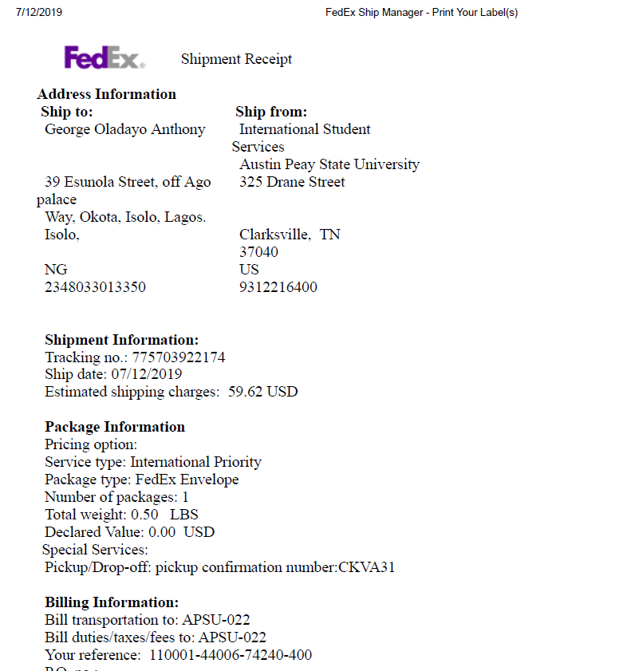
FedEx
When you ship with FedEx, you must send your shipping receipt with the FOAP to charge to Accounts Payable.
If I don’t receive your receipt or FOAP, it delays paying the bill on time.
If you are interested in setting up an online account, please let me know and I will have our account rep contact you.
Account code is 74240

Slide 17
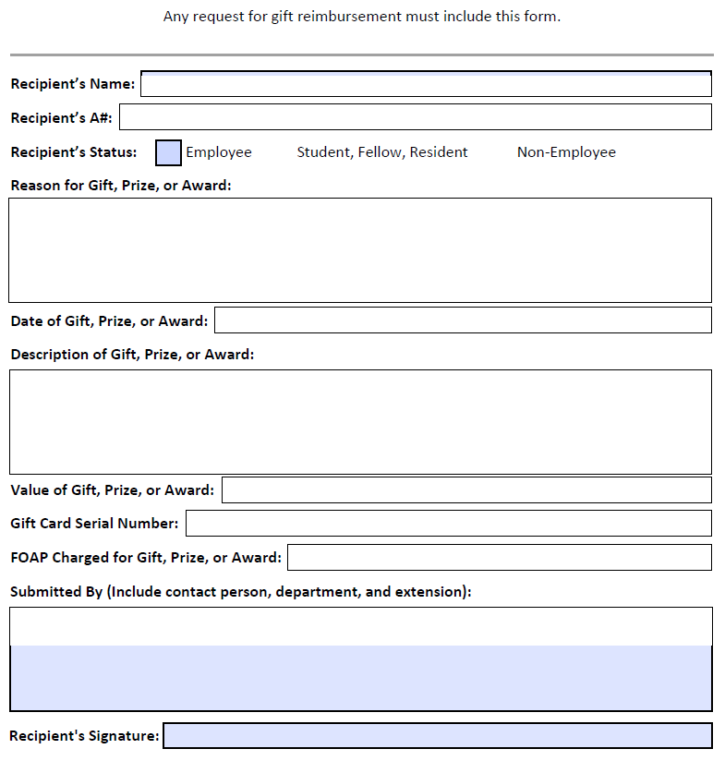
Policy 4:026
Cash and Gift Card Payments
The value of gifts, prizes or awards to employees, including student employees will be reported to payroll and will be added to the employees W-2 for proper tax reporting.
All others will be issued on a 1099 MISC and reported to the IRS if aggregate taxable payments received by such individual exceeds $600 during the calendar year.
All gifts, prizes and award payments for students will be reported to financial aid.
Gift card amounts should not exceed $100.00
Anything over $100.00 should be issued as a check.
You cannot purchase gift cards with your purchasing or travel cards. They must be purchased through Barnes and Noble or paid for personally and a payment authorization submitted afterwards for a personal reimbursement. All required documentation should be attached to your payment authorization when going this route.
Gift cards should only be purchased for the event and should not be purchased in bulk in advance for future events.
Gift cards cannot be mailed.
Gift cards not given out should immediately be taken to the cashier’s window for safekeeping. They should never be kept in your department.

Slide 18
Honorariums Explained
A true honorarium is a payment given for a professional service (such as giving a presentation or making a speech) that is rendered nominally without charge. The person providing the service is not expecting any type of payment.
If the person providing the service has to fill out paperwork (W-9, Minority/Ethnicity forms) they know some type of payment is coming.
Instead of calling it an honorarium, you should initiate a personal service agreement for a guest speaker, etc… on a Contract/Agreement Routing Form in Govs eShop.
This type of payment is considered income and can be reported to the IRS on a 1099 MISC.
If your intention is to only cover a minimal travel expense for the guest speaker, you may initiate a Travel Claim instead. Travel expenses are not considered income and are not 1099 MISC reportable.
If you have any questions, please contact Procurement and Contract Services for assistance with this.

Slide 19
Contracts
Pat Walton
Procurement & Contract Services
PO Box 4638
(931) 221-7573
waltonp@apsu.edu
Anita McKnight
Accounts Payable
PO Box 4635
(931) 221-7694
mcknighta@apsu.edu

Slide 20
Contacts Explained…
Just like other Purchase Orders, contract payments require:
1) a valid PO, 2) an invoice, and 3) a receiving report.
Since Procurement does not ask for invoices as part of the contract process, many of you start with an invoice from the vendor to start the contract process. Please attach the invoice on the Internal attachments tab, not in the Contract routing form. We want your invoice to transfer to the PO.
Answer the Quantity question on your requisition literally! If you are writing your PO as a lump sum amount, answer “No” so that the system will allow you to enter a Cost Receipt. Answering “Yes” but still putting “1 each” will limit you to authorizing the entire amount only and will not allow authorizing partial payments.
Receiving should be entered to authorize payment.
Thanks to everyone who asks their vendors for mailed payments, generally within 1 week of your event.
If you are authorizing that a paper check be prepared in advance for presentation at an event, you must enter receiving to trigger payment. If there are any event issues or cancellations, you MUST notify me in order that the check can be voided.
Please contact me at least 2 days in advance of your event to make sure I have everything needed to process payment.
KEEP IN MIND that direct-deposit options are offered to all vendors. If a vendor has signed up for direct-deposit, payment will automatically be delayed until the second day after your event to allow us to cancel a pending payment in the event there are issues. The vendor must be willing to receive payment a minimum of 4 days after the event to receive payment via direct-deposit.

Slide 21
Journals & Expenditure Transfers
Journals
  Used internally by Accounting Services
  If a data entry error is made on a payment authorization by Accounts Payable, then we file a journal to correct the accounting information
Expenditure Transfers
  Used when one department is charging another department
  If a coding error is made on a payment authorization by the department (wrong FOAP), they should file an expenditure transfer to correct the accounting information
    Requires appropriate signature
    Reason for request must be stated
    Attach supporting documentation if necessary

Slide 22
Travel
Geraldine Garner
(931) 221-7373
garnerg@apsu.edu
PO Box 4635

Slide 23

Automated Travel System
Travel Authorizations MUST be submitted at least two weeks before your travel begins
Login to OneStop
  Click on Web Self Service
  Click on the Finance Tab
  Click on Travel
  Select from the following options:
    Create New Single Trip Travel Authorization
    Create New Blanket Travel Authorization
    Create New Travel Claim

Slide 24
Paper Travel Authorization
Can be found by visiting Accounting Services website
Downloadable PDF file
For use prior to traveling
  by car
  by airplane
  to conferences
  etc…

Slide 25
Automated and Paper Travel Authorizations
What do I need to fill out on the travel authorization form?
  Fill out the top portion
  Tell us how you plan to travel
  List all expenses (or you will not be reimbursed for them)
  Airfare
    Paid by departmental credit card
    Travel card
    Paid by traveler
  Lodging (Conference exception)
  Meals and incidentals
    Per diem is still allowed, but meals will no longer be reimbursed for individual travel on the travel card…only group travel.
    In-State refer to TBR guidelines
    Out-of-State refer to CONUS - www.gsa.gov/perdiem
  Registration
    If it needs to be paid in advance, please fill out the bottom portion
  Total Expenses

Slide 26

Automated and Paper
Travel Authorizations continued…
Travel Advances
  Cannot exceed 80%
List FOAP (Fund-Orgn-Account)
Obtain appropriate signatures

Slide 27
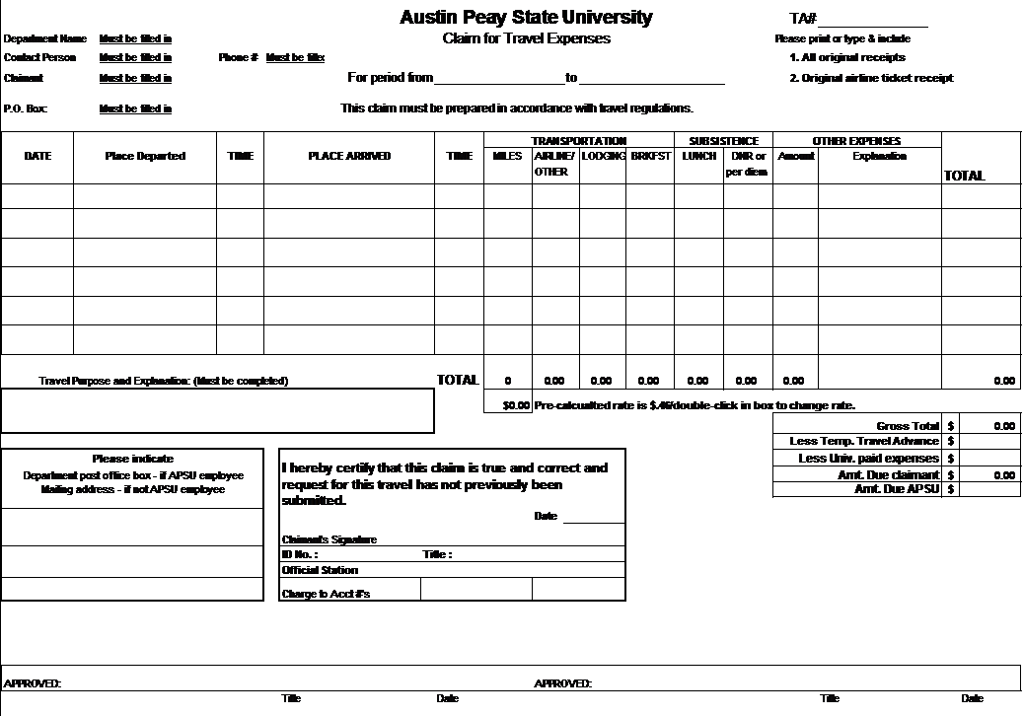
Paper Travel Claim

Slide 28
Automated and Paper Travel Claim
Must be filled out upon return from trip
Travel Claims must be submitted when using the travel card
Your original receipts are required
Mileage is paid at 47¢ per mile
Mileage is calculated using Rand McNally Tripmaker
Maximum parking fee is $8 per day without a receipt
Banquets/Luncheon
Phone calls (business)
Include FOAP (Fund-Orgn-Account)
Obtain appropriate signatures
Common Problems?

Slide 29
OneStop Login
Automated Travel Authorizations and Travel Claims

Slide 30
Questions?
Call Accounts Payable at
(931) 221-1037

